Slide 1
Real Time Sign Language Translation
DOMAIN:DEEP LEARNING
GUIDED BY:
MR.NIKHIL DHARMAN
TEAM MEMBERS:
AADEL ABOOBACKER
ABHIJITH N
AMAL P K
SAFDAR SHAHIR

Slide 2
ABSTRACT
Sign languages are full-fledged natural languages with their own grammar and lexicon. It is currently the most commonly used and effective communication language for hearing and speech impaired people. The foretold being a language which takes some time to absorb, most of us cannot remember or practice the signs as it is, also they do not need it other than communicating with the mentioned community.

Slide 3
Under this project, we are dedicated to find means to effectively deal with this communication issue using Deep Learning algorithms to train the path captured using mobile Camera. This dataset is thenceforth utilized to analyze the gestures and output the word. The output of our project includes three potential products including a mobile application, an application program interface and a sign language learning platform.

Slide 4
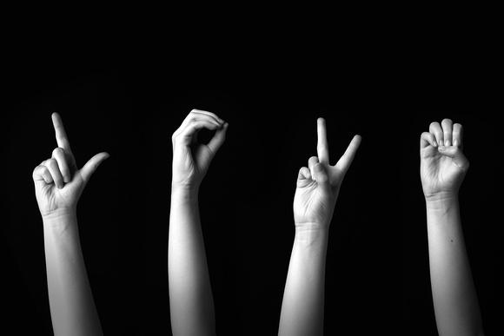
INTRODUCTION TO SIGN LANGUAGE

Slide 5
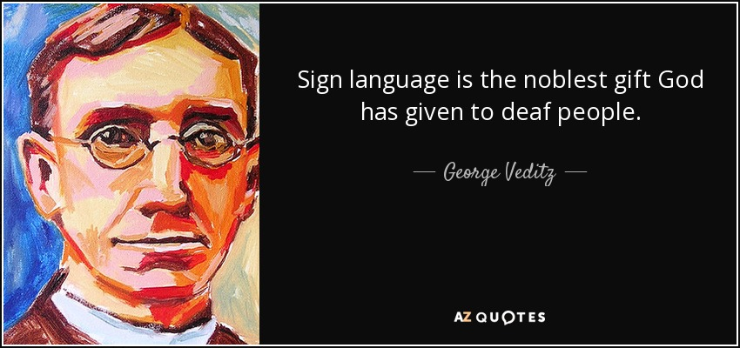
FORMER PRESIDENT : SIGN LANGUAGE COMMUNITY
FIRST TO FILM ON SIGN LANGAUGE

Slide 6
A language that employs signs made with the hands and other movements, including facial expressions and postures of the body, used primarily by people who are deaf.
There are many different sign languages as
AMERICAN SIGN LANGUAGE
BRITISH SIGN LANGUAGE
INDIAN SIGN LANGUAGE
FRENCH SIGN LANGUAGE

Slide 7

LITERATURE REVIEW

Slide 8
S.NO | TITLE | PUBLISHED BY | JOURNAL | DATE
1 | Hand gesture recognition for Indian sign language | Archana S Gotkar | ICCCI | JAN 11-12 2012
2 | Sign Language Recognition Using Modified Convolutional Neural Network Model | Suharjito, Herman Gunawan | IEEE | 7 Sept 2018
3 | Research on the Hand Gesture Recognition Based on Deep Learning | Jing-Hao Sun , Ting-Ting Ji | IEEE | 2018
4 | Dynamic Sign Language Recognition Based on Video Sequence With BLSTM-3D Residual Networks | YANQIU LIAO1 , PENGWEN XIONG1 , WEIDONG MIN2 | IEEE | March 14, 2019
5 | SignQuiz: A Quiz Based Tool for Learning Fingerspelled Signs in Indian Sign Language Using ASLR | JESTIN JOY 1,2, KANNAN BALAKRISHNAN1 , AND SREERAJ M3 | IEEE | March 18, 2019
6 | A Modified-LSTM Model for Continuous Sign Language Recognition using Leap motion | Anshul Mittal, Pradeep Kumar | IEEE | 2019

Slide 9
HAND GESTURE RECOGNITION FOR INDIAN SIGN LANGUAGE
A hand gesture recognition system to recognize the alphabets of Indian Sign Language
4 Modules
real time hand tracking,
hand segmentation
feature extraction
gesture recognition.
Camshift method and Hue, Saturation, Intensity (HSV) color model are used for hand tracking and segmentation
Genetic Algorithm is used for gesture recognition

Slide 10
SIGN QUIZ
A sign language learning tool that uses automatic sign recognition
In this proposed system we capture the sign from the user using a camera.
The captured photograph is normalized and given to a Deep neural network with an Softmax classifier.
Softmax classifier is generally used in multiple class classification problems.
The photograph of the sign is detected using the neural network for an interactive sign language learning tool.
Results indicate that the signQuiz is better than printed medium for fingerspelled sign learning.

Slide 11
A Modified-LSTM Model for Continuous Sign Language Recognition using Leap motion
Continuous sign recognition system for sentence formation
In this paper they used a leap motion sensor to capture the sign.
This leap motion sensor will generate a set of points and its x,y,z coordinates
Using Feature extraction and normalization the input to the neural network is created in a uniform pattern.
A 2D Convolutional neural network is used for Feature extraction.
Using this feature maps are created that are fed to LSTM(Long Short Term Memory)
In this paper they propose a Modified LSTM that consist of an Reset(R) gate which helps in segmenting the continuous sign sequence as well as in improving the recognition performance.
The proposed system has been tested with 942 signed sentences of Indian Sign Language (ISL).
These sign sentences are recognized using 35 different sign words.
The average accuracy of 72.3% and 89.5% have been recorded on signed sentences and isolated sign words.

Slide 12
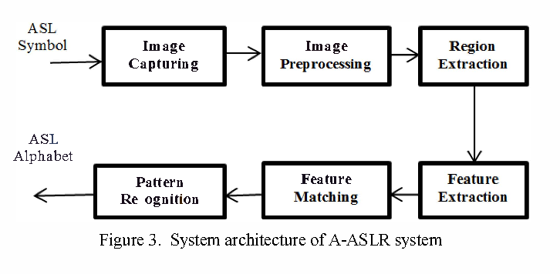
Design

Slide 13
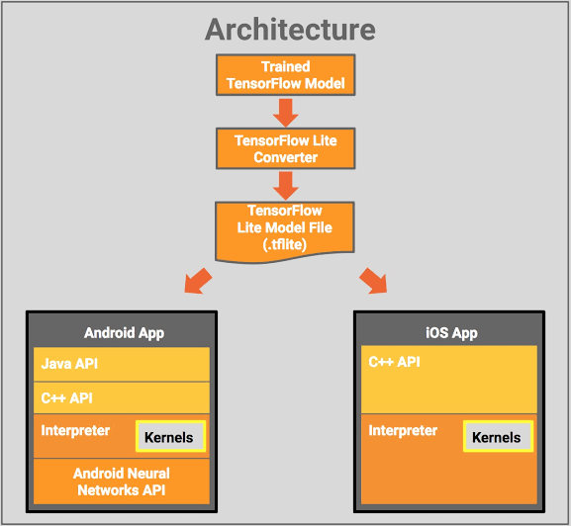

Slide 14
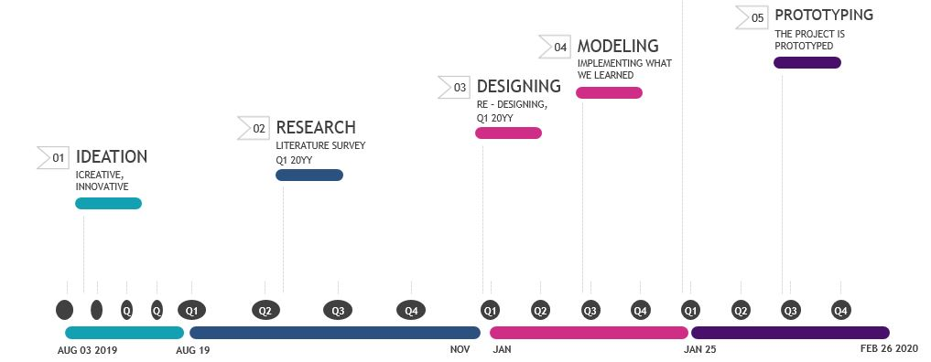
TIMELINE

Slide 15
CONCLUSION
Product : Real Time Sign Language Translation and tutoring platform
More efficient than Gesture-gloves
Coet Efficient
Implemented in any sign language.

